Slide 1
ELL205 PROJECT
IMAGE ENCRYPTION AND DECRYPTION
By:
ARIN KEDIA
NIKHIL UNAVEKAR
MEHUL KAMBOJ

Slide 2
Encryption & Decryption:
ENCRYPT(IMAGE) :-
WE STORE THE IMAGE AS A PIXEL_ARRAY.
WE APPLY DISCRETE FOURIER TRANSFORM ON EACH ROW OF PIXEL_ARRAY.
WE MUTATE THE ARRAY WITH RESPECT TO THE KEY ACCORDING TO THE ALGORITHM WE USE.
FURTHERMORE INVERSE FOURIER TRANSFORM IS APPLIED TO THE RESULTING ARRAY.
WE TAKE THE TRANSPOSE OF THE RESULTING ARRAY.
FURTHER REPEAT THE ABOVE PROCESS.
STORE THE RESULTING ARRAY AS AN IMAGE WITH NAME ENCRYPT.JPEG
DECRYPT(ENCRYPTED IMAGE) :-
WE STORE THE ENCRYPTED IMAGE AS A PIXEL_ARRAY.
WE APPLY DISCRETE FOURIER TRANSFORM ON EACH ROW OF PIXEL_ARRAY.
WE MUTATE THE ARRAY WITH RESPECT TO THE INVERSE OF THE KEY ACCORDING TO THE ALGORITHM WE USE.
FURTHERMORE INVERSE FOURIER TRANSFORM IS APPLIED TO THE RESULTING ARRAY.
WE TAKE THE TRANSPOSE OF THE RESULTING ARRAY.
FURTHER REPEAT THE ABOVE PROCESS.
STORE THE RESULTING ARRAY AS AN IMAGE WITH NAME DECRYPT.JPEG

Slide 3

INFO ON KEY
The key is a pair of Naturals(r1,r2).
Inverse of the key(r1,r2) is (-r2,-r1).
MUTATE
WHILE MUTATING THE ARRAY WE DO :-
We take each row of the array and we apply multr of the row and a complex number $e^{−2πj∗i∗o/(size of row)}$.
Here o is the order by which we mutate and i the index of the row.
MULTR
For each element of the array on which the multr is applied, let the index of that element be i. We multiply the element by $z^{i}$ and the element at the index n-i by $z^{−i}$. Here n is the size of the array.

Slide 4
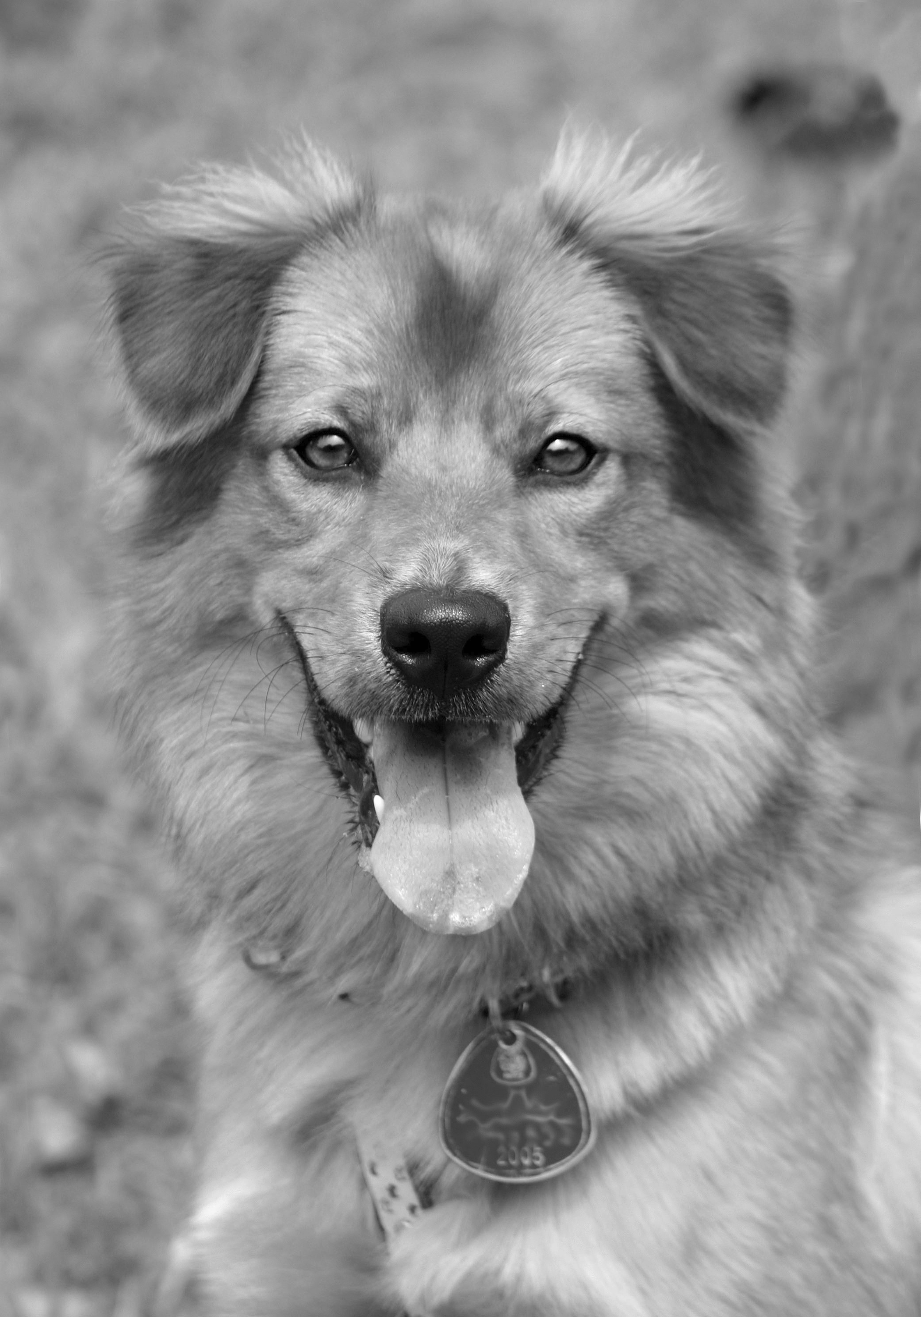


EXAMPLE
(56,69)
ENCRYPTION KEY
(56,69)
DECRYPTION KEY

Slide 5

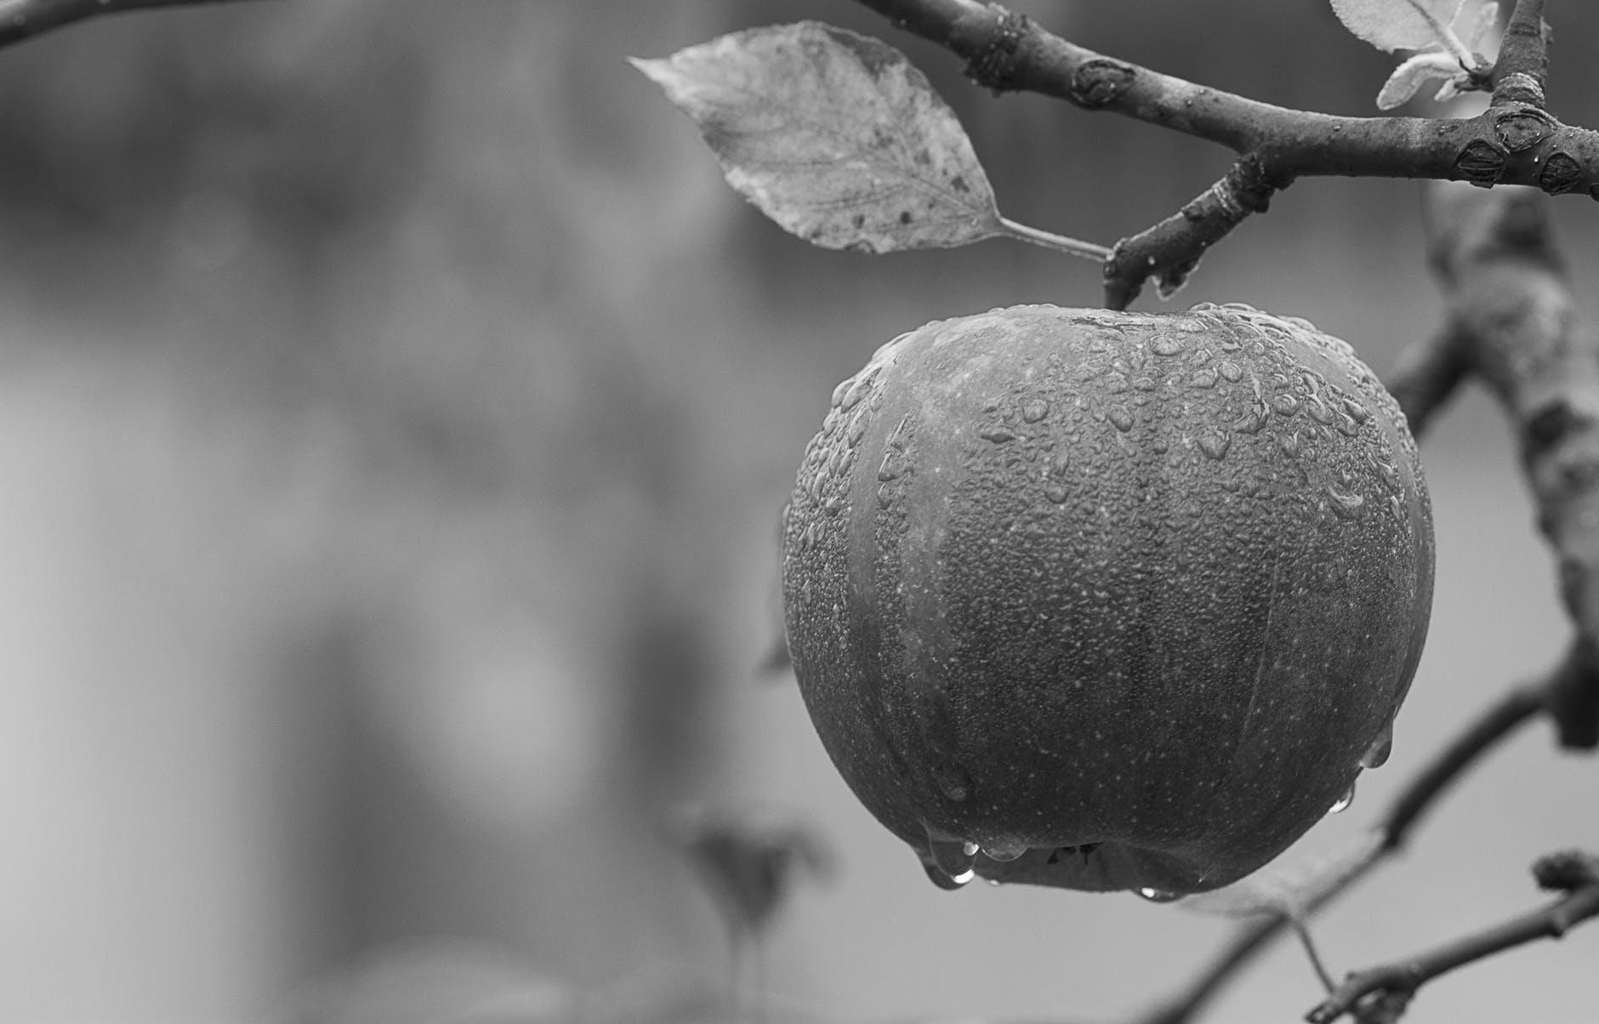

EXAMPLE
(56,69)
ENCRYPTION KEY
(56,69)
DECRYPTION KEY

Slide 6


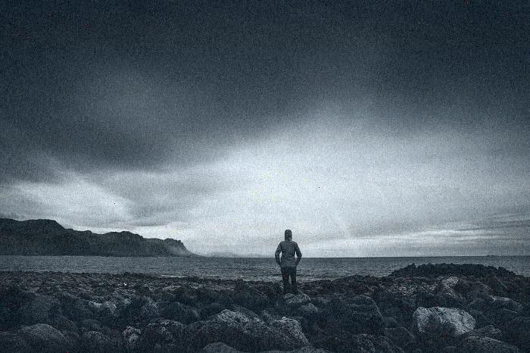
EXAMPLE
(56,69)
ENCRYPTION KEY
(56,69)
DECRYPTION KEY

Slide 7
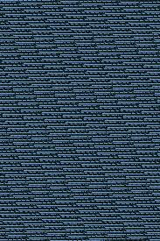
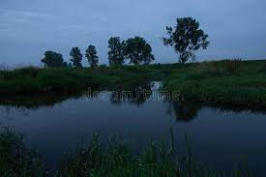
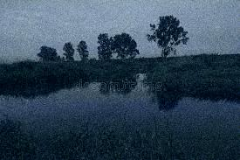
EXAMPLE
(56,69)
ENCRYPTION KEY
(56,69)
DECRYPTION KEY

Slide 8

WHEN DECRYPTED WITH WRONG KEY
(56,69)
ENCRYPTION KEY
(56,60)
WRONG DECRYPTION KEY

Slide 9
THANK YOU

